Slide 1
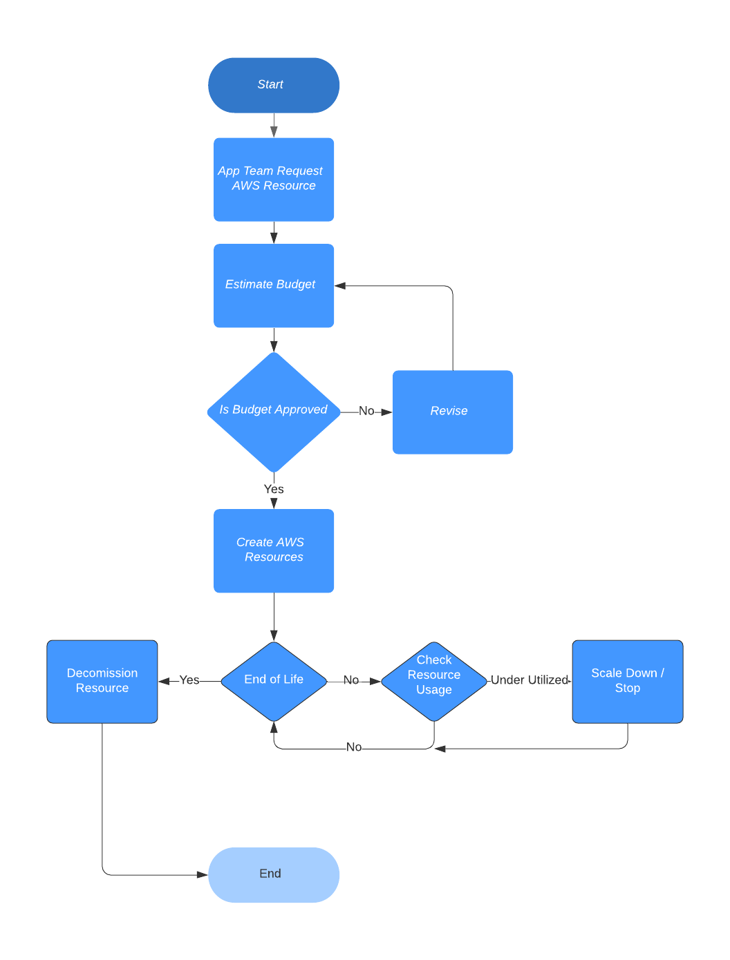
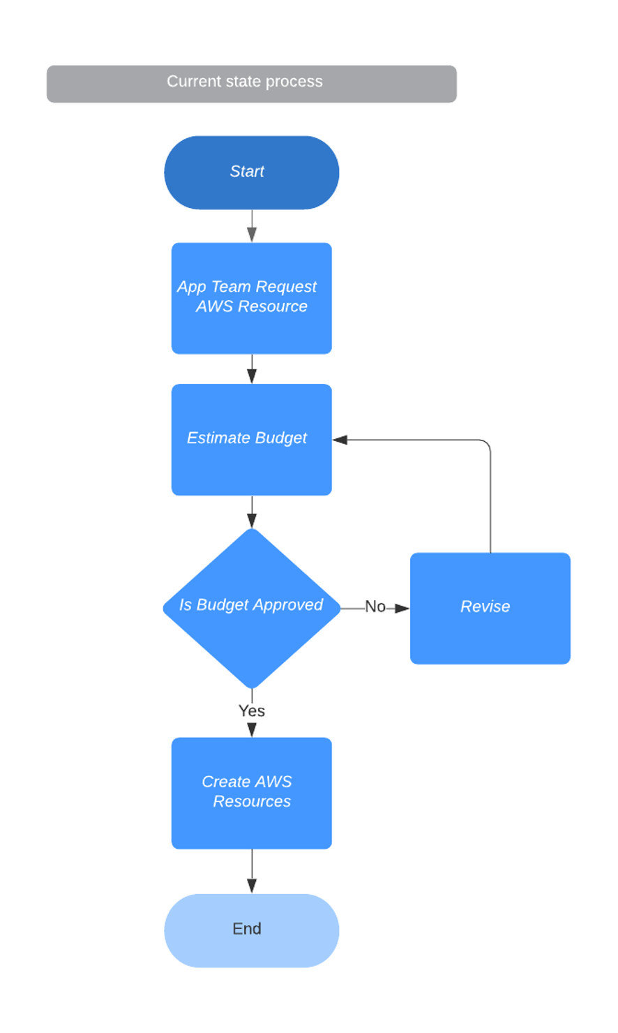
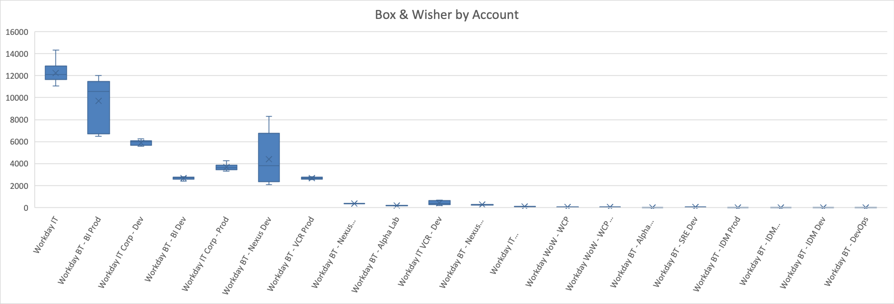
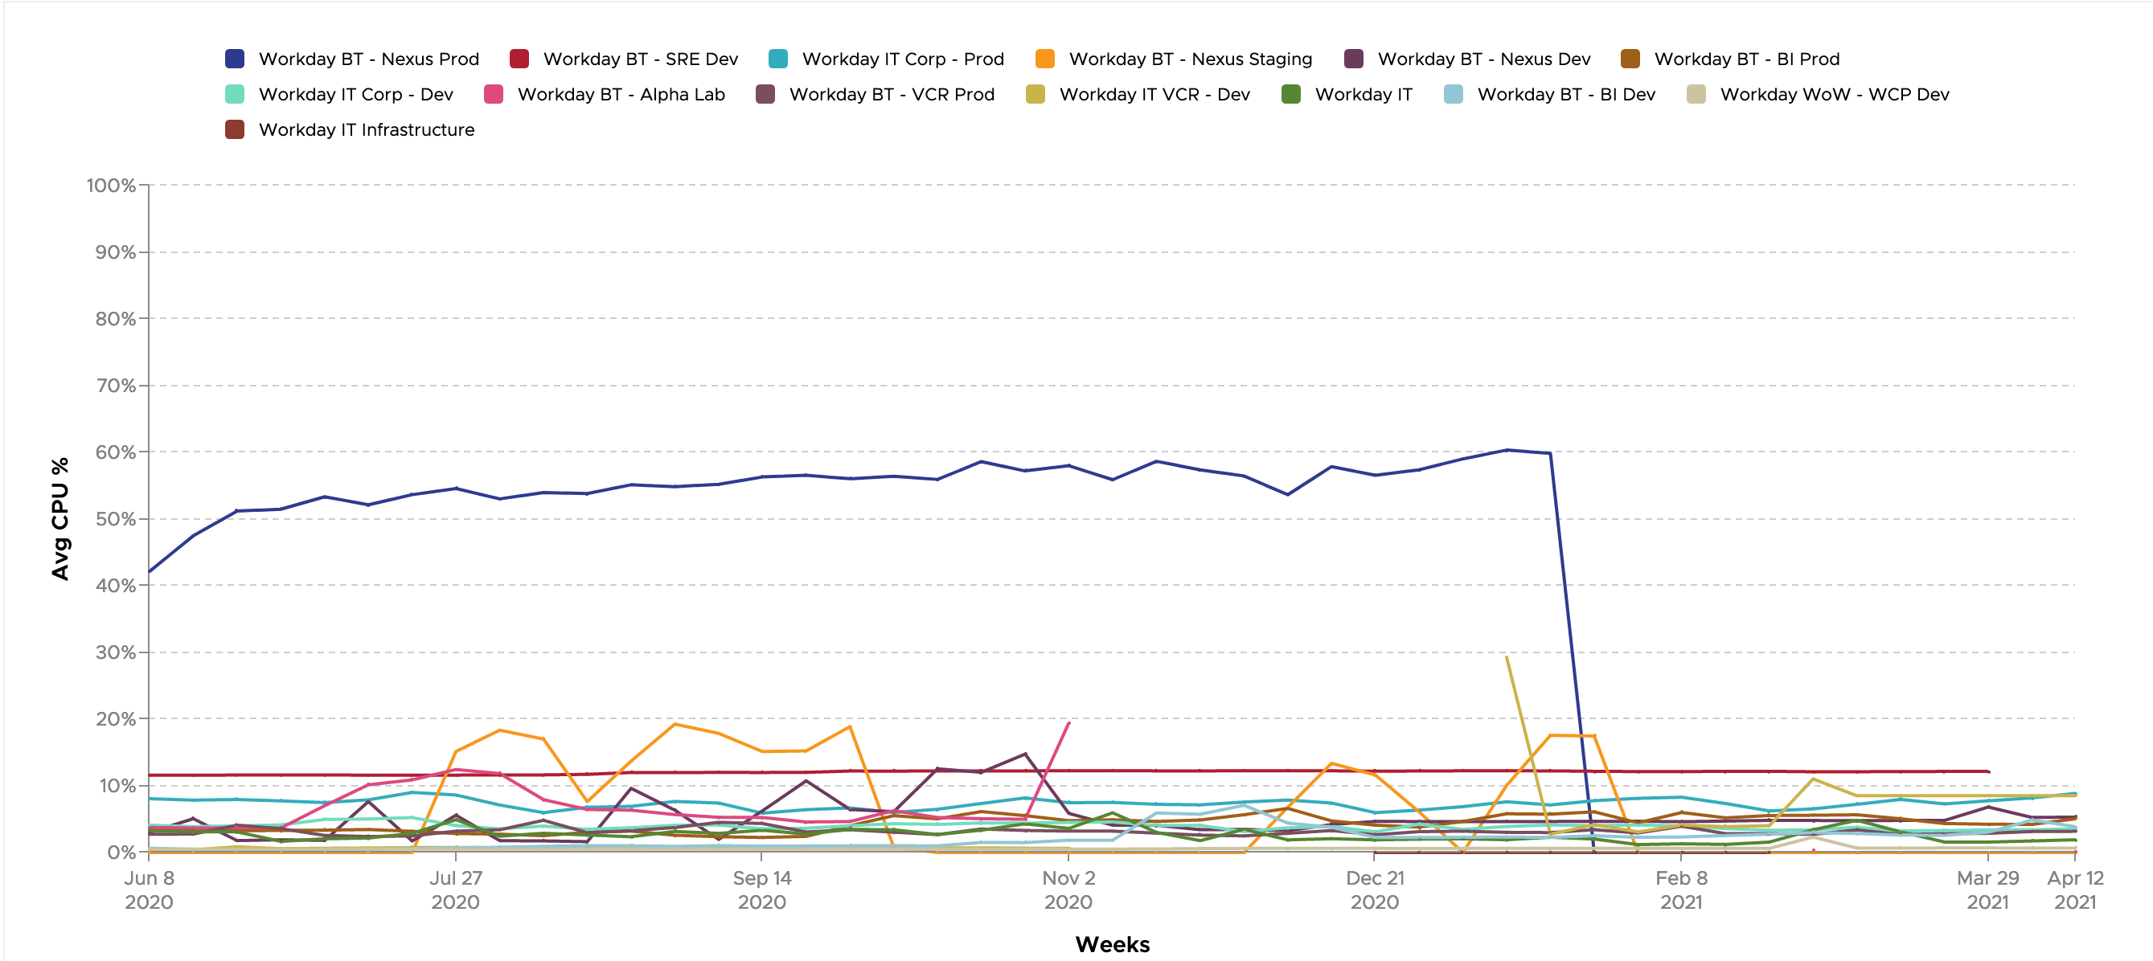
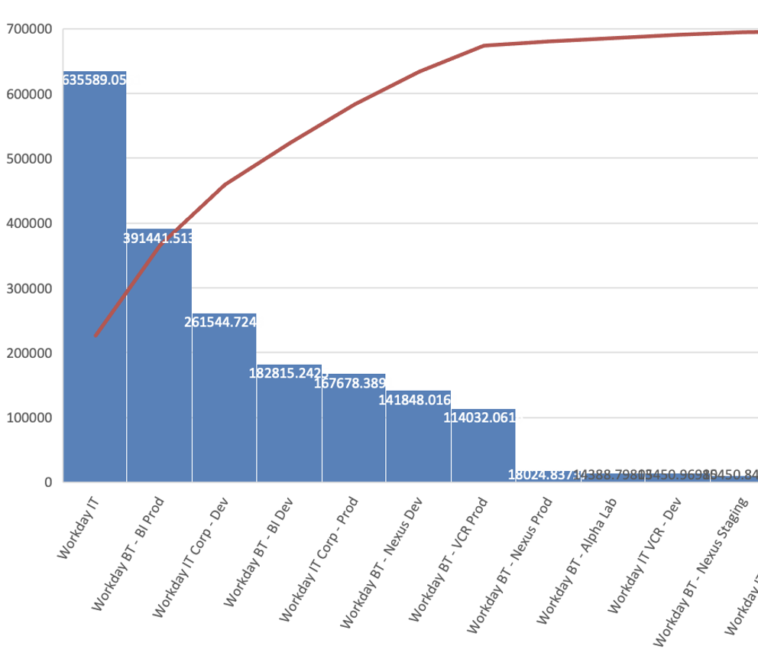
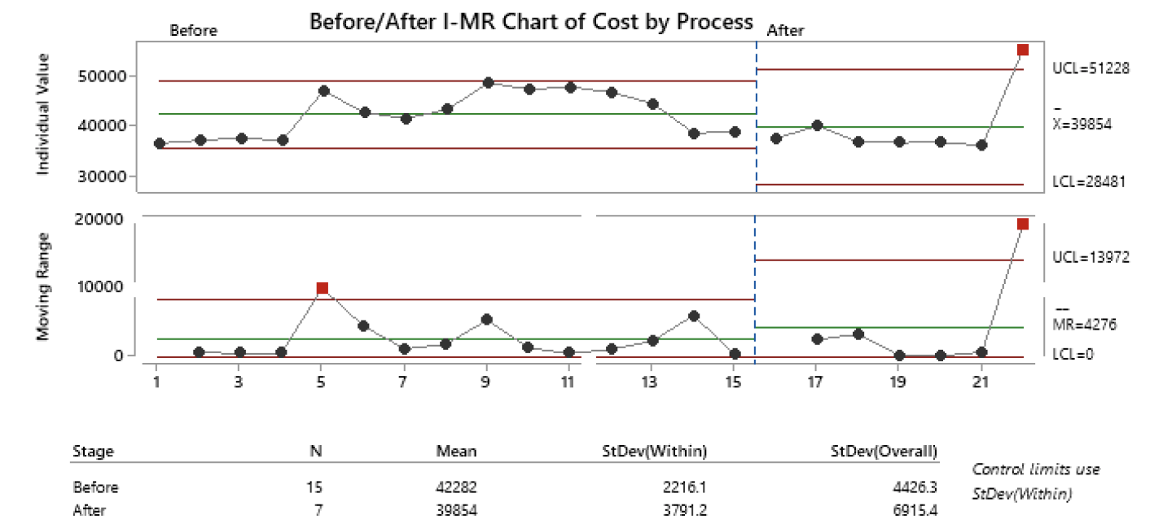
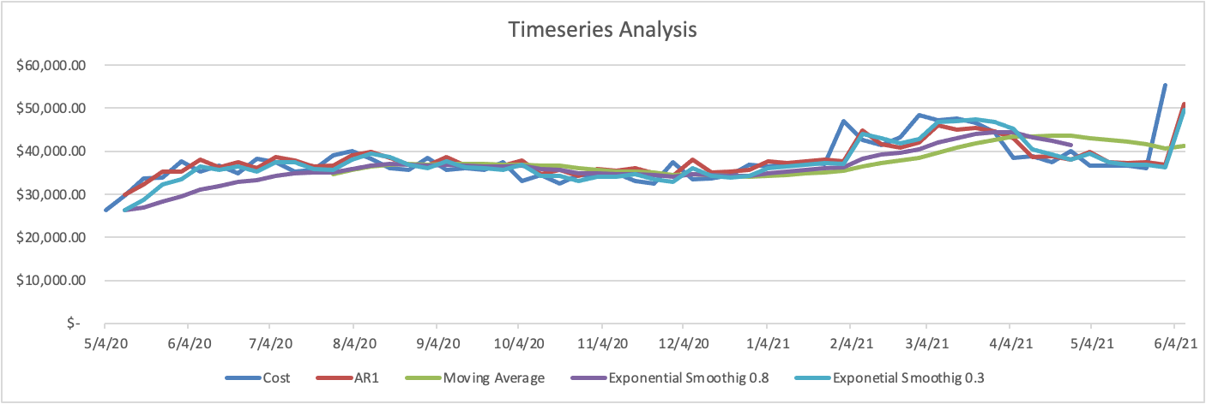
MBC 638 AWS COST CONTROL PROJECT
Process Owner: Systems Engineering
KEY DATES | DEFINE: 4/15 | MEASURE: 4/26 | ANALYZE: 4/30 | IMPROVE: 5/3 | CONTROL: 6/4
DEFINE | MEASURE | ANALYZE | IMPROVE
Problem To Solve The month over month cost of AWS resource usage increases at a rate more significant than the allocated budget for the year Business Impact If the cost is not controlled, we might not have the budget to execute the projects planned for the later part of the year. The AWS cost for the first quarter of 2021 is at 550K. The projected cost is a total of 3.5 million for the remainder of the year, which is 75% more than what is budgeted around 2 million for 2021. | Collect data on 3 continuous and 2 discrete variables Discrete: Team, Type of AWS Service Continuous: Time, Service Cost, Utilization | Box and Whisker plot showing high variations in one of the development and production account
 |  |  | CONTROL
 |  |  | Continue monitor the process Implement the second , right size control and observe.
Fail to reject Ho, introducing EOL alone didn’t bring down the cost to budget
The dev account investigation revealed an EOL system got activated by mistake
Data Stratification Tree
SQL 0.8
SQL 1.2
Introduced End Of Life System Monitoring & Right Sizing
Original Process Map
Pareto Chart – General IT and BI group consuming most of the cost
The Trend chart showed under utilization of the CPU across teams, which costs more
Timeseries showed spike in cost after May and reduced in later part of the year, need to investigate further

Slide 2
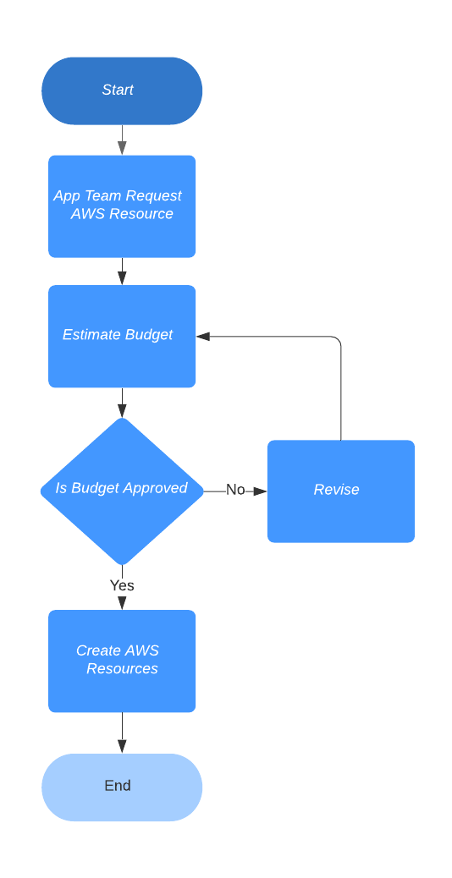
Current State Process
Talked to the team on the current process and captured the workflow
The current process involves creating a simple JIRA ticket and attaching the approval to create the required AWS resource

Slide 3
Data Stratification Tree
Questions about Process |  | Stratification factors X Variable | Measurement
Does cost impacted by type of service used | Cost Output Y | Team | The product group
Does cost impacted by week, month, like quarterly workloads | Output Y | Type of Service | AWS Service Type
Does cost impacted by any new service consumption? |  | Time | Week of the year or Day of the Year
How much of the services bought being utilized , did we over subscribe the resource? |  | Service Cost | Cost of the service by time
Does cost impacted by the teams |  | Utilization | CPU and Memory Utilization

Slide 4
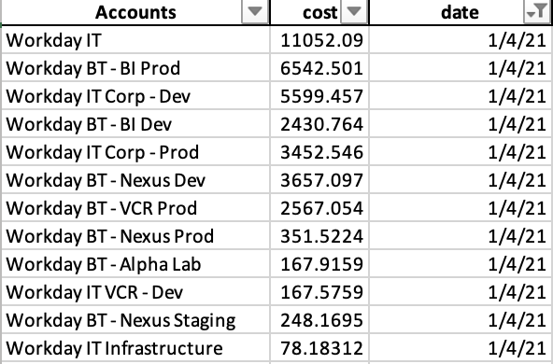
Data Collection
How did we collect
Collected AWS Cost History
Collected centrally in cost management system Cloud Health
Able to export the weekly cost summary from the cloud health system
What did we Collect
3 continuous and 2 discrete variables
Discrete: Team, Type of AWS Service
Continuous: Time, Service Cost, Utilization

Slide 5
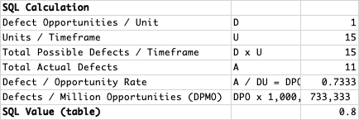
Baseline SQL
Determined the baseline for the process before any improvements began with the data collected for 15 weeks
Defect Definition
Weekly cost more than the allocated budget
SQL baseline
Between 0.8 and 0.9

Slide 6
Success Measure
We ideally want to meet our original estimates for the year of 2 Million
Target is to save around 1.5 million for the rest of the year
Need to achieve Weekly Target per week cost of $37800

Slide 7
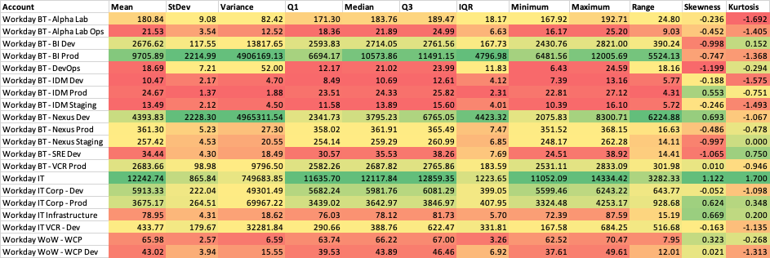
Descriptive Stats
Production Accounts consume more than Development Accounts
2/3rd of accounts are dormant or low use
Workday IT is our top consumer

Slide 8
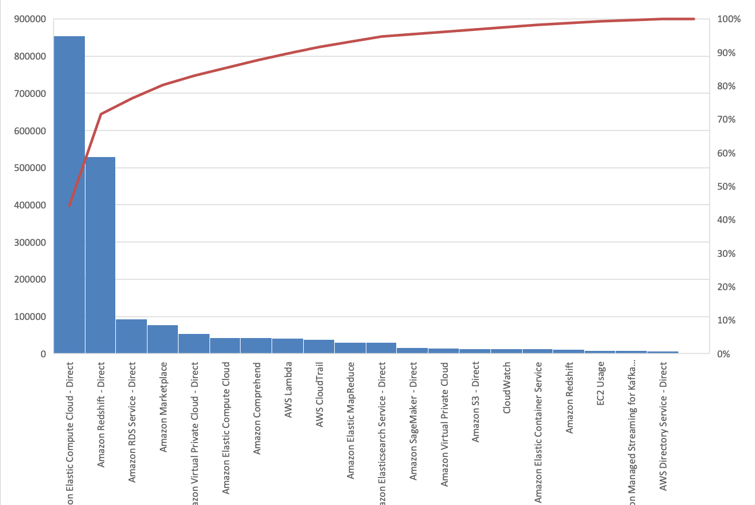
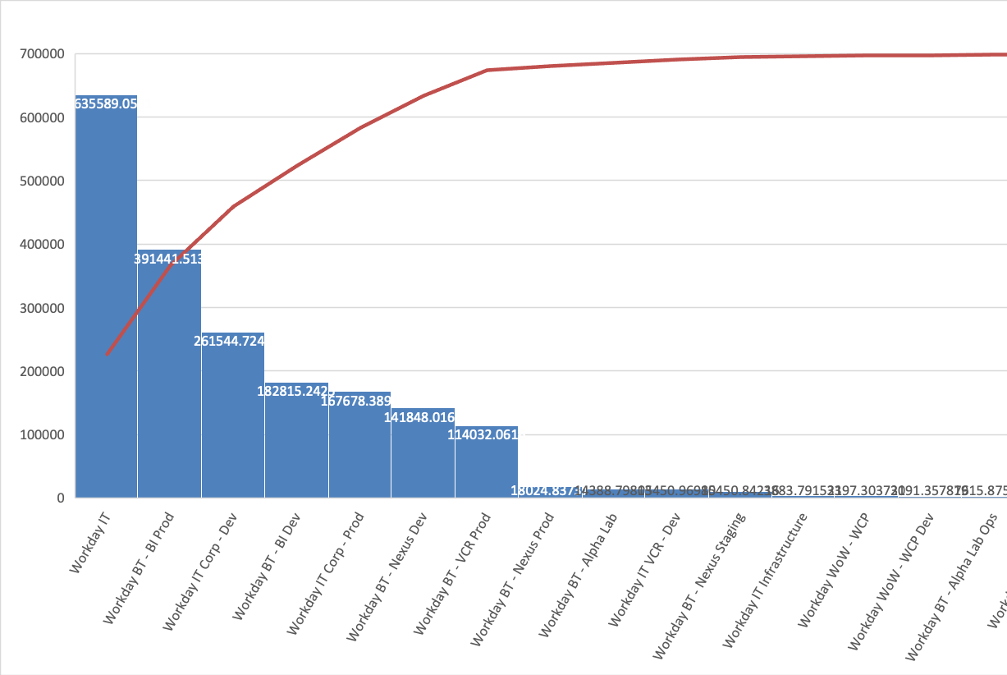
Analysis - Pareto Chart
Pareto Chart showed Workday IT and BI Accounts using most of the Cost, the expectation is to uncover some optimization on them
Also, most of the cost comes from EC2 and Redshift, so we expect to uncover some optimization on their usage

Slide 9
Analysis – Box Plot
The boxplots showed high variance in Nexus dev account and Bi Prod Account
Nexus dev was unexpected
On further investigation we identified a decommissioned system got accidentally activated in Nexus Dev
The box plot showed an unexpected source of cost in dev
Need to have a monitoring solution to check the end of life(EOL) systems

Slide 10
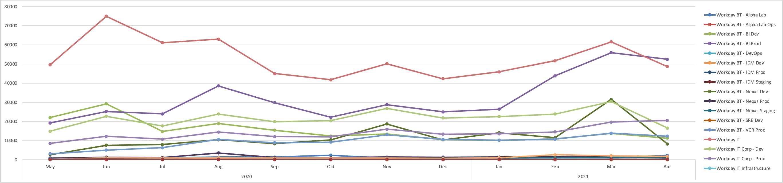
Analysis -Cost Trend
The trend chart showed spike in cost for BI Prod and Dev, Nexus Dev and Workday IT Accounts
All of them show a considerable uptick in January 2021

Slide 11
Analysis - Utilization Trend of CPU by Compute Nodes
The Pareto Chart showed EC2 and Redshift as our major cost contributor
Since the EC2 and Redshift nodes are priced by the size of CPU, we looked at the trend of the CPU utilization
The trend showed the under utilization of the CPU
Means the clusters are over provisioned, costing us more, so we need to right size them

Slide 12
Improve - Target State Process
All of the steps are BVA, since it’s a platform team, the service is used by multiple project teams to deliver customer value
Identified two opportunities to control the cost
End Of Life system enforcement, based on the observation from the nexus dev
Right sizing the compute resource, based on the observation from the CPU utilization
Implementing the controls on the overall process to monitor for EOL and right sizing
Only EOL is done manually in the short term

Slide 13
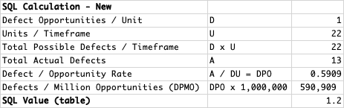
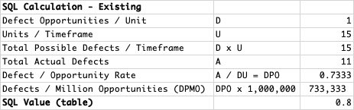
Improved Process SQL
Calculated the SQL with just one process improvement
The new SQL is between 1.2 to 1.3, resulting in 0.4 improvement

Slide 14
Improve - Hypothesis Testing - One Sample T test
With Target = 37800 , the original Weekly Budget, we can not statistically conclude that the new process achieved our goal of controlling the cost
We have too few samples to conclude, will collect more samples in the following weeks and verify

Slide 15
Control – IMR Control Chart
The upper and lower limit widened, indicating overall it got worse
We have one out of control point contributing to the shift
All other points are below the mean
Indicating some other change occurred to our process, we need to investigate

Slide 16
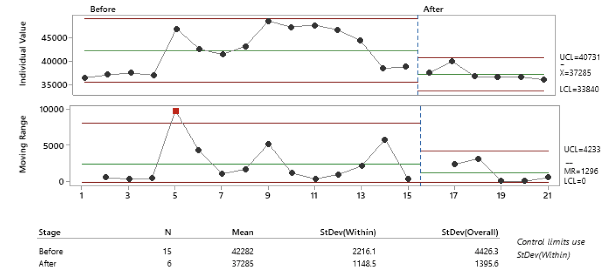
Control Chart without last sample
Excluded the last sample and ran the control chart to see if the last outlier we see bring in any other unintended change
The mean of the individual value decreased
And mean of the moving rage also decreased
So, the process improved without the last point, but we got some other change got introduced in our process
Need to investigate the change, data is not available yet

Slide 17
Timeseries Analysis
Used past years data in time series to observer any seasonality
There is lower cost on later part of the year, but higher cost just after May
So, the cost might come down on later part of the year possibly bring our process in control
Need to investigate why there is an increase after May by getting last years account wise data
Need to work with analytics team to get detailed historical data

Slide 18
Sample Size
The total sample size is 22.
Sample in Baseline Process : 15
Sample in Improved Process : 7
For a margin of error of 3800 dollars (10% of budget) , we need 9 samples to test our change with 90% confidence, we got only 7 samples
We are limited by the time period to measure our improvement,
It is a continuous process and will measure for the next few weeks and re verify
X bar = | 39854.1943
s = | 6915.42
α/2 = | 0.05
t_{α/2} = | 1.645
Margin of Error = | 3800
Lower Bound = | 43654.1943
Upper Bound = | 36054.1943
Samples Needed | 8.96193386

Slide 19
Measurement Error
Since this is reported by the AWS service, the repeatability and reproducibility is high
We get same numbers from their API every time
This is the Bill the AWS is sending us, so they can’t walk back
So, in our case the measurement error is zero

Slide 20
What we learned
Identified two opportunities to control the cost
End Of Life system enforcement
Right sizing the compute resource
End Of Life system enforcement
Worked with systems team to shut down the decommissioned system on the short term
Working with system team to setup alert on the EOL monitoring
Right sizing the compute resource
Working with system team to dynamically adjust the compute resources
Since this needs to be applied for each workloads we are initiating a POC with BI group to automate the workload sizing and planning to extend to other groups
Will continue monitor the control chart and verify the change
Investigate the increase in cost starting June by collecting more account wise data from last years

